Slide 1
HEBSE
Holistic Exploration of Binary Stellar Evolutions
SDMay25-20
Members: Andrew Snyder, Alex Polston, Alek Norris, Eamon Collins, James Byrd, Svyatoslav Varnitskyy
Client & Advisor: Dr. Goce Trajcevski

Slide 2

Context
Binary Stars: A pair of stars bound to each other by gravity, revolving around a common center of mass within each others’ orbit
The POSYDON research project simulates binary star system evolution, generating massive amounts of data
Notes:
Before we talk about our project a little context
Astrophysics study stars bound to each other by gravity called binary stars to gain insight into stellar evolution
However, experiments in the science field are costly so astrophysicist run simulations to study the behavior of different binary star systems

Slide 3
Problem Statement
Complex Query Example:
Find all systems which have a mass ratio between 0.5 and 0.7 and at some point an orbital period between 5 and 100 days.
SELECT "binary_history"."model_number", "binary_history"."age" FROM "binary_history"
WHERE ("binary_history"."star_1_mass”/"binary_history"."star_2_mass" BETWEEN 0.5 AND 0.7 OR "binary_history"."star_2_mass" /"binary_history"."star_1_mass" BETWEEN 0.5 AND 0.7)
AND "binary_history"."period_days" BETWEEN 5 AND 100
Problem - Currently there is no system to effectively search the vast simulation data for particular subsets, i.e. a “complex query.”
Solution - Implement a software tool with an intuitive user interface, database setup, complex querying, and data retrieval capabilities with optional OpenAI natural language processing assistance.

Slide 4

Project Overview
Key Features:
  Import multivariable time-series simulation data into relational database
  Retrieval of previous queries
  Enable custom SQL and natural language queries
Deliverables:
  Web Based Application
  Relational Database
  Data Ingestion Capability
Notes:
Next Let's take a high level overview of our project
Problem
No existing solution to query binary star simulation data generated by POSYDON project
Requires coding knowledge and knowledge of about 100 parameters
An Example query that needs to be translated into SQL statement:
Systems which have a peak mass transfer rate of greater than X after the primary has formed a black hole
Statements like these are difficult to code without a good understanding of the database
Objective
Develop an intuitive system accessible to anyone to query compatible binary stars systems
Some main Features
Develop tool to ingest large amounts of CSV multivariable time series data into relational database
Implement a UI that has ability to query database using SQL or natural language processing
And the UI should also include predetermined sample queries
As a result our Deliverables
Web based application which user will interact with
Relational database to store simulation data
Data ingestion tool to import simulation data into database

Slide 5
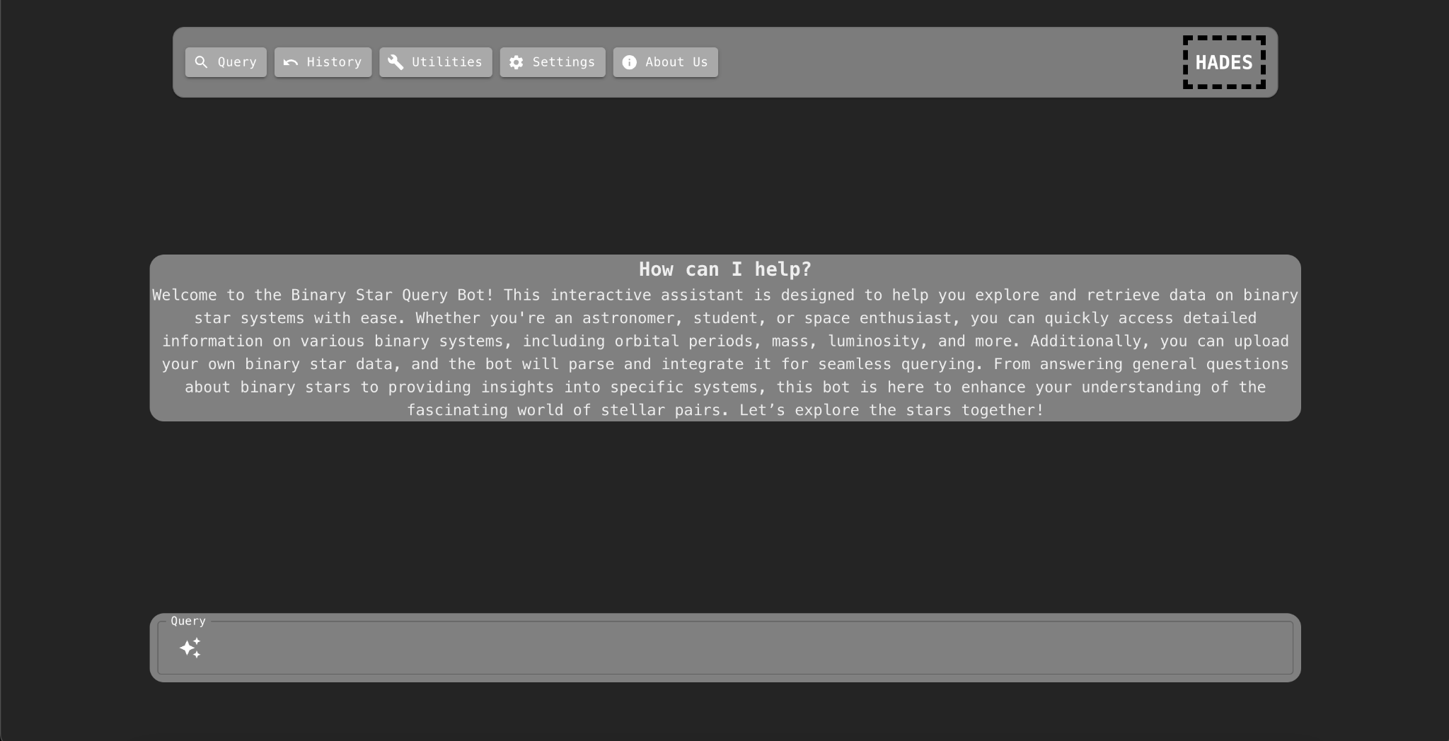
UI Prototype
Notes:
So what we came up to address these concerns is this
This is the users primary point of interaction with our system
Currently the concept query page is being displayed where users will be able to enter custom queries or basic words to query a database

Slide 6
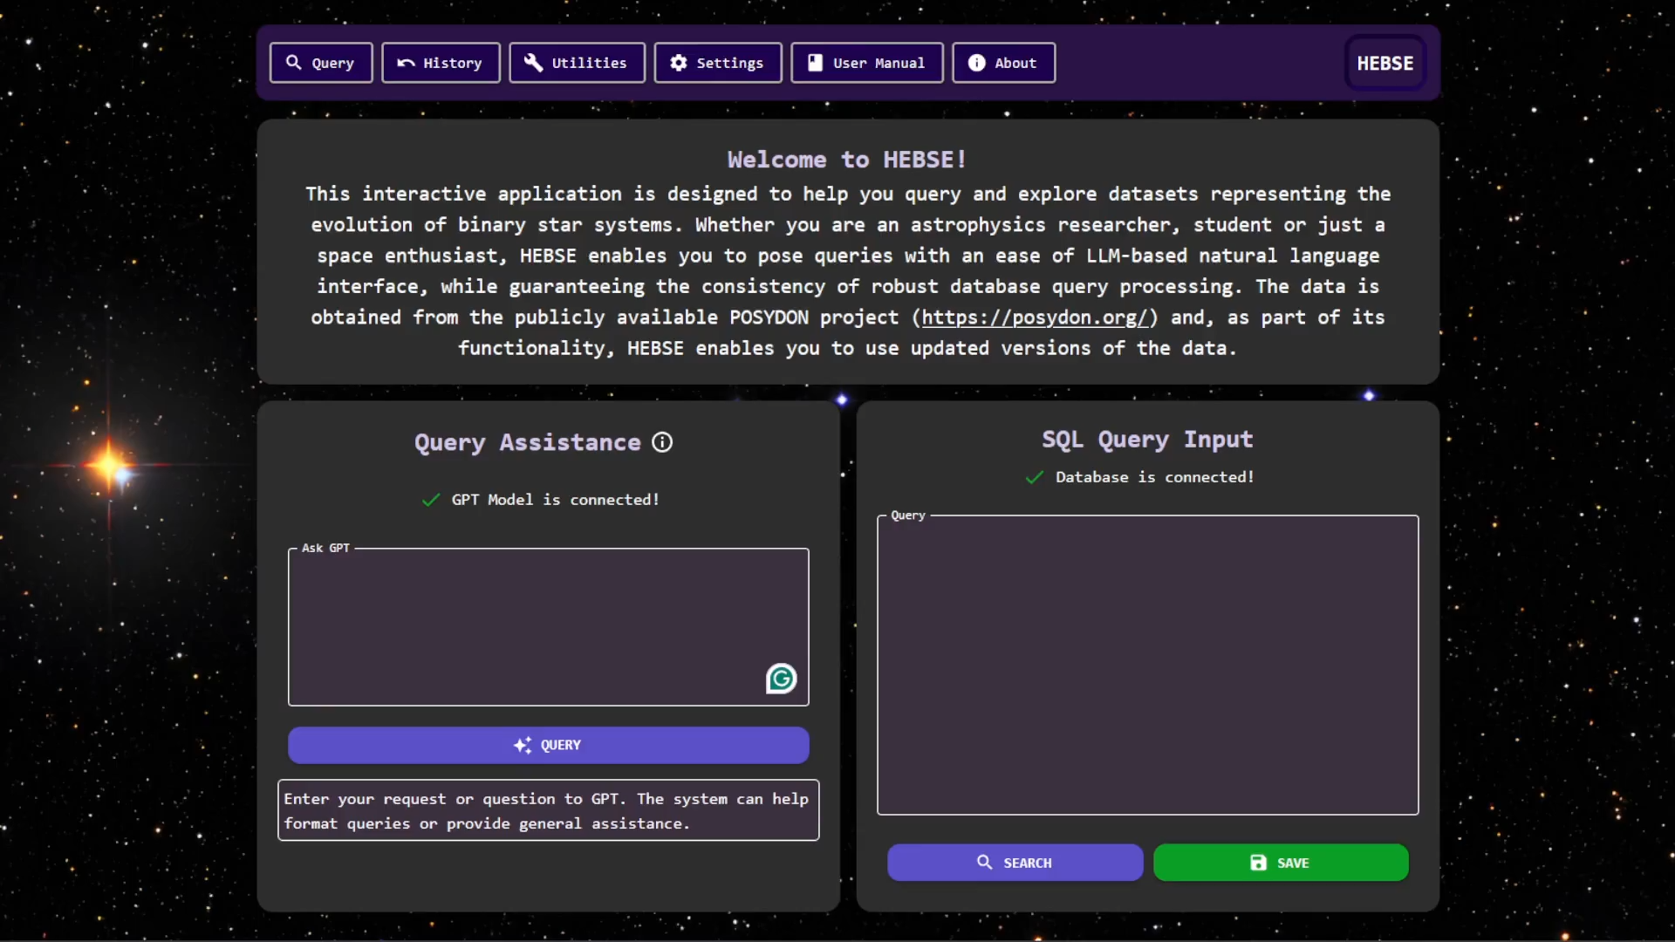

Slide 7
Requirements
Functional | Non-Functional
Correctly convert CSV files into PostgreSQL database Generate functional SQL queries from natural language Previous and built-in requests are easily retrievable | Visually appealing and easily navigable user interface Time-efficient data parsing Clear presentation of data Secure data transmission and storage
Notes:
Looking at our project requirements, Our goal was create a user friendly app for those without experience making database queries, while still allowing for advanced users who want to create custom queries.
Functionally,
Correctly import dataset CSV files into an SQL database.
Generate proper SQL queries from natural language.
Queries can also be saved to a collection for future use.
Non-functionally,
Application needs to be easy for the users to understand and navigate,
efficient in its retrieval of data from the database,
and clear presentation of that information.
Encrypted for secure data in motion and at rest

Slide 8

Resource Requirements
Sufficient storage to maintain a large database
Database can be local or remotely hosted
Sufficiently powerful computer to run the tool
More powerful -> faster response times
OpenAI API key for NLP query assistance
Optional, user choice
Notes:
Resource Requirements for our application are pretty dependent on use case, meaning if a user has advanced needs, they will likely need a more advanced system to accommodate them.
Following that, they will need enough storage to host their database, either locally or remotely.
They will need a system capable of running the application. Simple use cases will have low system requirements, while more advanced applications will require more resources. More system resources like memory and processing power will produce faster application performance.
And, optionally, if a user desires to use our NLP query assistance feature, they will need an OpenAI key to connect a GPT model to power it.

Slide 9

Risks Encountered & Mitigations
Risks | Mitigation
Security | Encrypted credential storage, SSH and HTTPS protocols.
Limited Dataset Availability | Parsing script designed to strictly follow all known conventions
NLP Query Inaccuracies | Thorough testing and training. Full disclosure of generated query to user for vetting with results.
Notes:
Now, onto some of the risk factors affecting our project.
Missing deadlines is countered with regular and quality communication with each other and our advisor.
Difficulties with software pieces are mitigated by using well documented tech, and having options available if parts aren't meshing well.
Because of the large amounts of data being searched and fetched, performance may be slow. This is somewhat outside our scope to fix, but possible fixes could be indexing important data columns for quicker searching.
And lastly, due to the slight unpredictability of using an NLP based on user input, results may not be 100% accurate 100% of the time. We will spend time thoroughly testing and training the AI to generate queries in the correct format.

Slide 10
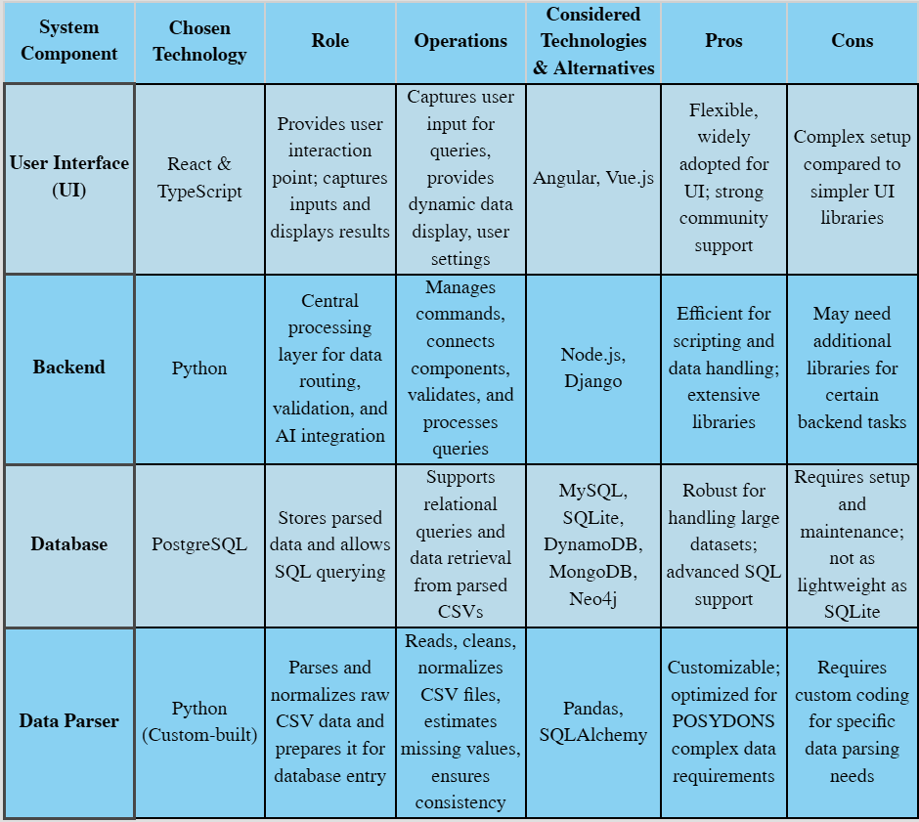
Design Decisions
Database management system - PostgreSQL
Custom data types for data grouping and ease of access
User Interface - React
Modular approach, quick and easy modification of application components
Natural Language Processing - OpenAI API
Easy integration with applications
Offloads computational load to OpenAI servers
Notes:
React - For user interaction, entering information to connect etc, acts as main point of interaction for user
-Flexible, widely adopted for UI, Compartmentation of Frontend and User local OS interactions.
Backend Python - Connects the frontend to the database, uses FAST-API to allow api calls from frontend to interact with all other technologies.
Also works with the script to automate using the scripts, building the database for the user if wanted etc.
Quick to develop, advanced flexible functions, allowing a smaller code base overall to help with
PostgreSQL, stores parsed data, history data.
-Customizable, optimized, free, and relatively scalable for systems.

Slide 11
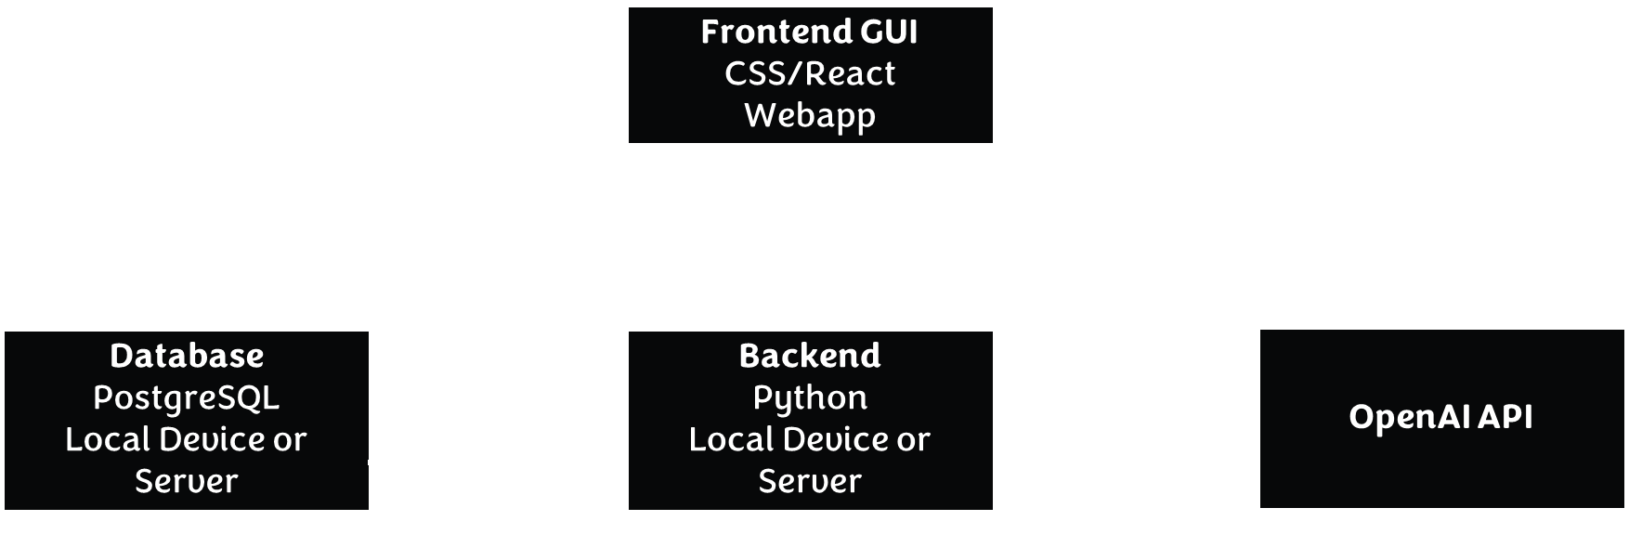
Implementation
Notes:
The Design for our system consists of 4 main components,
The Backend, The Database, The UI, and a connection to The OpenAI API
The GUI, a web app, connects to The Backend, and communicates SQL queries, AI assisted questions and program data, through a secure connection.
The backend, which can be locally or remotely hosted, connects to the Database and to the OpenAI API. All through secure connections.

Slide 12
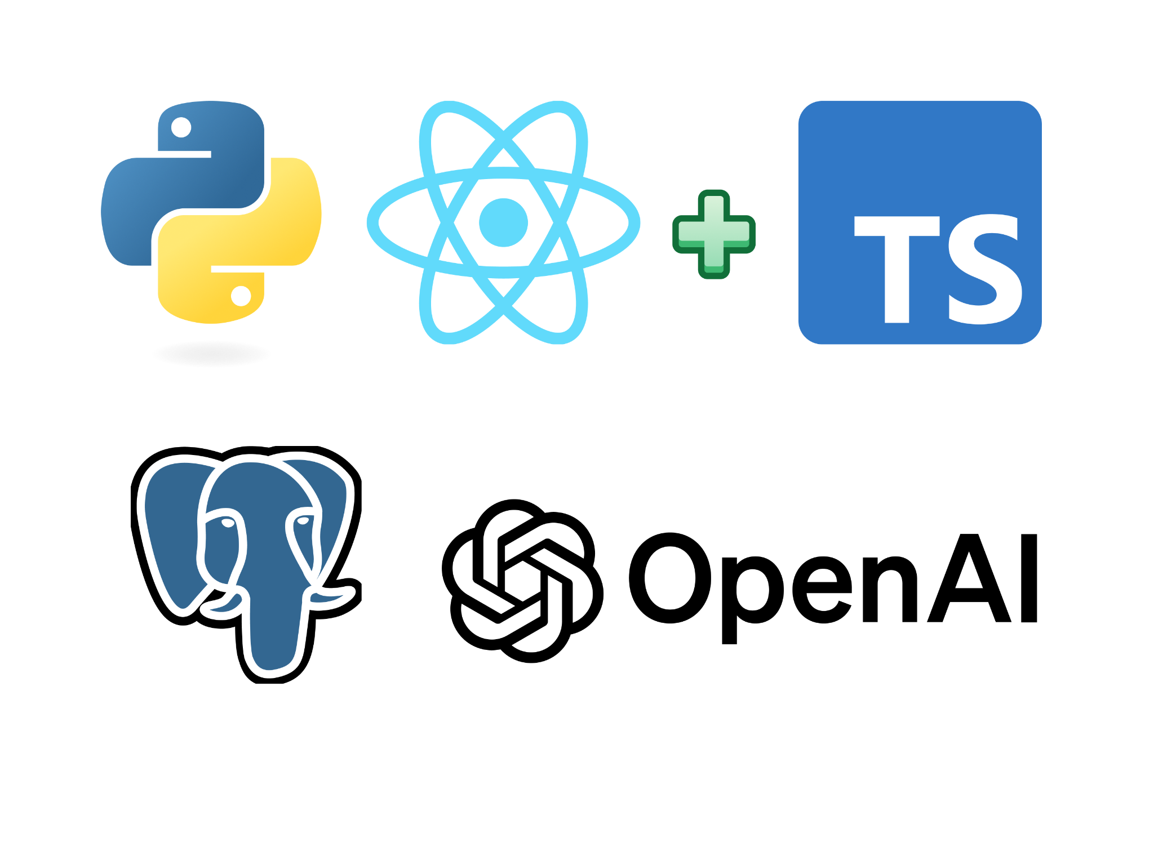
Tech Stack
Notes:
Backend Python
Frontend React and TypeScript
Database PostgreSQL
LLM OpenAI API

Slide 13
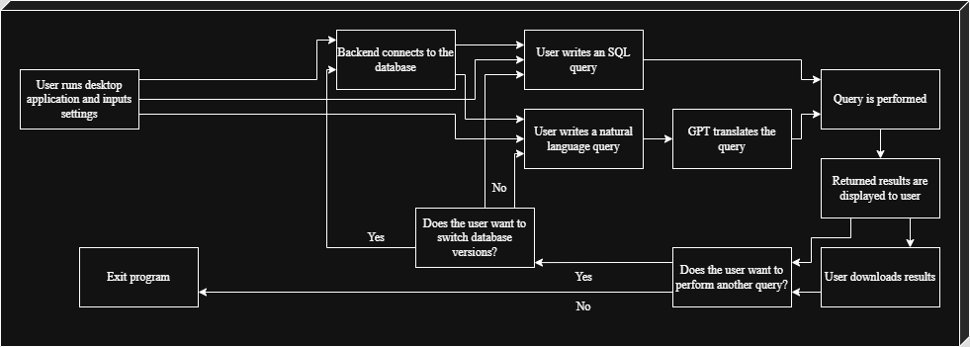
User Interaction Pathway
Notes:
So how does a user use our app,
Launch the desktop app
Connect the database
Write a query directly or with help from AI
The submit the query
Can view and download the results.

Slide 14


Comprehensive Testing
Unit Testing:
Vitest (frontend) and Tox (backend)
100% coverage ​
Regression Testing:
GitLab pipeline utilized to run regression tests prior to merging
PyTest
Acceptance Testing:
Client input into all stages of development
Feedback implementation​
Notes:
For unit testing
Utilized Vitest as the frontend testing framework
Jest DOM Library and React Testing Library
Utilized Tox for backend testing with Pytest as the framework
We achieved 100% coverage
For regression testing
Set up pipeline job to verify backend testing coverage and linting requirements pass
Job to verify frontend linting requirements
Job to verify frontend tests pass and coverage requirement was met
If any requirement was not met branch prevented from merging
For acceptance testing
Worked with client every sprint to receive feedback on progress
Put feedback into defect gitlab issue and reconnected on next sprint

Slide 15


Final Thoughts
Achievements
Finalized an application that exceeds initial goals
Robust UI for POSYDON integration and offline query support
Supports local, remote, and hybrid backend modes
Secured data in storage and transmission with encryption
Lessons Learned
Clear design goals from Fall helped streamline Spring development
Modular design allows for easier component development
A visually pleasing and organized UI is key for user experience
Notes:
In conclusion,
Our achievements consistent of
Our completed application exceeded initial goals and stakeholder expectations
Created professional user interface
Versatile configuration setup the supports local, remote, and hybrid backend
Encryption for credentials
100% coverage ensuring a robust code
Some of the lessons we learned
Good design foundation from previous semester helped development flow smoothly
Modular component design enables testing and maintainability
Visually appealing UI creates a positive user experience

Slide 16

Thank You
Questions?

